Slide 1
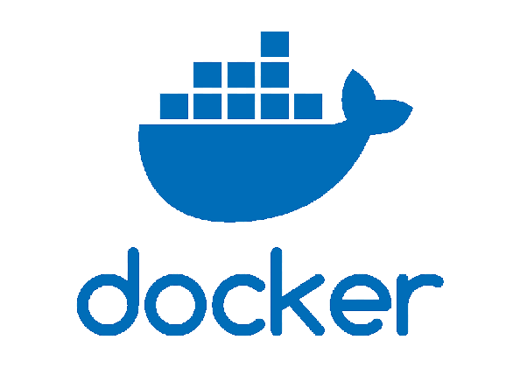
Introduction To Docker
What is Docker?
Docker is a popular platform designed to simplify the creation, deployment and management of applications using container technology. Containers allow developers and IT professionals to package applications and their dependencies into a single, consistent environment, ensuring that they run reliably across different computing environments.

Slide 2
Introduction To Docker
Why Docker Was Created?
Before Docker, running applications across different environments (such as development, testing and production) often led to compatibility issues because of varying dependencies, libraries, or OS configurations. Docker containers solve this issue by providing a standardized unit (the container) that packages everything the application needs, isolating it from other applications and system resources.
Application
Operating System
Hardware
Application
Operating System
Hardware
Application
Operating System
Hardware
Development Server
Test Server
Production Server
DEVELOPMENT ENVIRONEMENT
QA/TESTING ENVIRONEMENT
PRODUCTION ENVIRONEMENT

Slide 3
Introduction To Docker
History of Docker:
Origin and Creation (2010):
Docker was originally created by Solomon Hykes as part of a project called "dotCloud", a platform-as-a-service (PaaS) provider.
The project started with the idea of simplifying the deployment of applications using lightweight containers.
Initial Release (March 2013):
Docker was officially released as an open-source project at PyCon 2013. It used Linux containers (LXC) as its underlying technology, which allowed developers to package applications and their dependencies into standardized units called containers.
Docker’s goal was to make it easier to create, deploy and run applications by packaging them with all their dependencies in a portable container.

Slide 4
Introduction To Docker
History of Docker:
Docker Inc. (2013):
The company dotCloud changed its name to Docker, Inc. to reflect the focus on the Docker container technology.
Docker rapidly gained attention and began growing in popularity due to its simplicity, efficiency and ability to solve long-standing challenges in application deployment and scalability.
Docker Hub (2013):
Docker introduced Docker Hub, a registry service for sharing and distributing Docker images.
This was a key step in making Docker containers widely accessible and reusable.

Slide 5
Introduction To Docker
History of Docker:
Container Standardization (2014):
Docker began working to standardize container formats. The Open Container Initiative (OCI) was formed in 2015 to define open standards for container formats and runtimes.
Docker’s adoption helped bring containers into the mainstream, and companies began using it for development and production workloads.
Docker Engine and Swarm (2014-2015):
Docker introduced Docker Engine as a core component for running containers.
In 2015, Docker Swarm was released to provide native clustering and orchestration of Docker containers, giving users the ability to manage a cluster of Docker engines as a single entity.

Slide 6
Introduction To Docker
History of Docker:
Kubernetes Emerges (2015-2016):
The rise of Kubernetes (initially developed by Google) as a container orchestration platform began to overshadow Docker’s own orchestration solution, Swarm.
Kubernetes became the dominant container orchestration tool, but Docker continued to be the most popular container runtime.
Introduction of Docker Compose (2014):
Docker Compose, a tool for defining and running multi-container Docker applications, was introduced.
This made it easier to manage multi-container applications using simple configuration files.

Slide 7
Introduction To Docker
History of Docker:
Docker for Windows and Mac (2016):
Docker introduced Docker for Windows and Docker for Mac, making it possible to run Docker containers natively on non-Linux operating systems.
Partnership with Microsoft (2017):
Docker entered into a partnership with Microsoft, which enabled Docker to be integrated into Windows Server and made Windows containers possible.
Acquisition by Mirantis (2020):
In 2020, Docker’s enterprise business, including Docker Enterprise (formerly Docker Swarm and Docker EE), was sold to Mirantis, a cloud solutions company. Docker refocused on providing Docker Desktop and Docker Hub for developers.

Slide 8
Introduction To Docker
History of Docker:
Docker Today (2023):
Docker has solidified its place as one of the leading tools for developers to package and run applications in containers.
The company focuses on Docker Desktop, Docker Hub and enhancing the developer experience with tools like Docker Compose and Docker Buildx.
Docker remains a central part of the container ecosystem but is often used in combination with Kubernetes for orchestration and management of containers at scale.

Slide 9

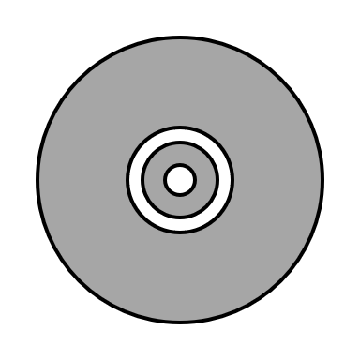
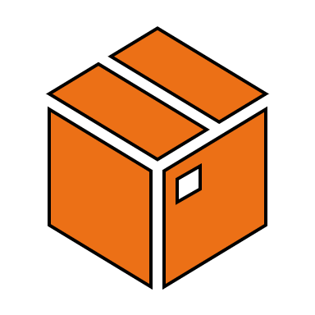
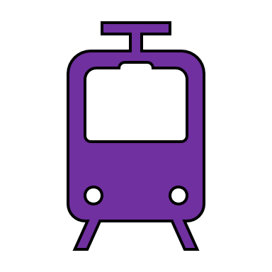
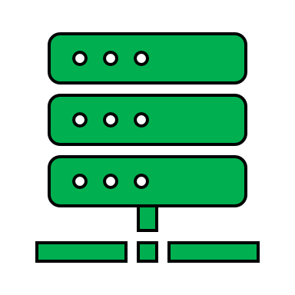
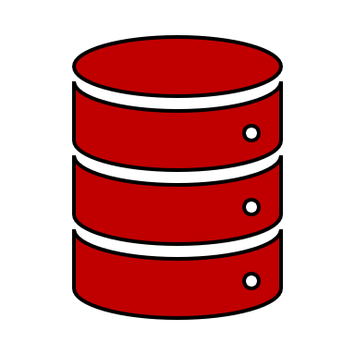
Introduction To Docker
Key Components of Docker:
Docker File
Docker Image
Docker Container
Docker Hub
Docker Engine
Docker Volume

Slide 10

Introduction To Docker
Docker Containers:
Containers are at the core of Docker. They provide isolated environments for applications to run independently on the same host, which avoids conflicts between different applications. Containers are lightweight, portable and easy to manage.
An instance of an image.
It's a lightweight, standalone package that includes everything needed to run an application.
Docker Container

Slide 11
Introduction To Docker
Docker Images:
Docker images are the read-only templates that contain the application code and all dependencies. When an image is run, it becomes a container. Images are built using Dockerfiles, which contain a series of instructions for building an application’s environment.
Read-only templates that are used to build containers.
Images are created with Dockerfile instructions or can be downloaded from a Docker registry like Docker Hub.
Docker Image

Slide 12
Introduction To Docker
Docker File:
A Dockerfile is a script containing a set of instructions on how to build a Docker image. It specifies which base image to use, which dependencies to include and how to configure the application within the container.
A script-like file that defines the steps to create a Docker image.
Docker File

Slide 13
Introduction To Docker
Docker Engine:
The underlying technology that powers Docker, including the Docker Daemon, which manages containers on a system and the Docker CLI (Command-Line Interface), which lets users interact with Docker.
The Docker engine is responsible for running and managing containers.
It's composed of the Docker daemon and the Docker CLI that communicates through REST API.
Docker Engine

Slide 14
Introduction To Docker
Docker Hub:
The official public registry where Docker images can be stored and shared. Docker Hub allows developers to upload and download images, making it easy to share and reuse containers.
Repositories where Docker images are stored and can be distributed from.
Docker registries can be public or private.
Docker Hub is the default public registry that Docker is configured with.
Docker Hub

Slide 15
Introduction To Docker
Docker Volume:
Docker volumes are a persistent storage solution that lets you store and manage data for containers outside their file system, so data can persist even if the container is stopped or deleted. Volumes are managed by Docker and are a good choice for storing data generated by and used by Docker containers because they can easily be shared among containers and are independent of the container lifecycle.
Allow data to persist outside of a container and to be shared between container instances, even after a container is deleted.
Volumes decouple data life from the container lifecycle.
Docker Volume

Slide 16
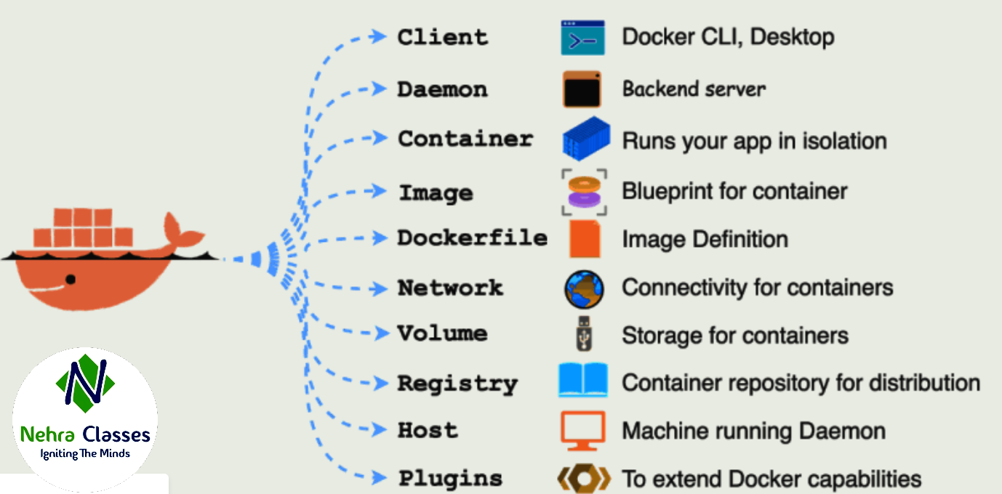
Introduction To Docker
Components of Docker:

Slide 17
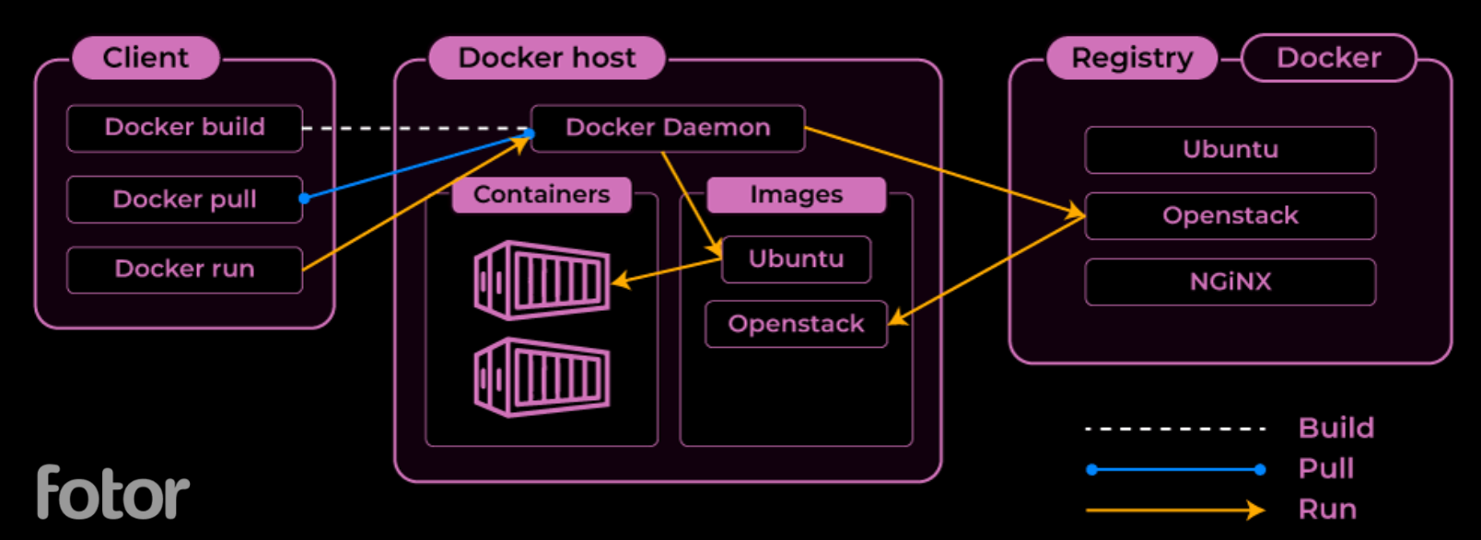
Introduction To Docker
Architecture of Docker:
Docker makes use of a client-server architecture. The Docker client talks with the docker daemon which helps in building, running and distributing the docker containers. The Docker client runs with the daemon on the same system or we can connect the Docker client with the Docker daemon remotely. With the help of REST API over a UNIX socket or a network, the docker client and daemon interact with each other.

Slide 18
Introduction To Docker
How Docker Works?
Building an Image: Developers write a Dockerfile that contains instructions for setting up the application environment. Using docker build, Docker reads the Dockerfile and creates an image based on those instructions.
Running a Container: Once the image is built, it can be run as a container using docker run. This container is an instance of the image, fully isolated from other containers and the host system.
Managing Containers: Containers can be started, stopped and deleted easily using Docker commands and they can be scaled up or down as needed to meet application demands.

Slide 19
Introduction To Docker
Benefits of Using Docker:
Consistency Across Environments: Containers encapsulate everything an application needs to run, so it behaves the same way across development, testing and production.
Resource Efficiency: Containers are lightweight and share the host OS kernel, making them more resource-efficient than traditional virtual machines.
Portability: Docker containers can run on any system with Docker installed, from a developer’s laptop to large cloud servers, without modification.
Scalability: Docker integrates with orchestration tools like Kubernetes and Docker Swarm, allowing applications to scale efficiently.

Slide 20
Introduction To Docker
Use Cases of Docker:
DevOps and Continuous Integration/Continuous Deployment (CI/CD): Docker simplifies and automates the software release process, allowing applications to be tested and deployed faster.
Microservices Architecture: Docker enables the creation of modular services that can be scaled and managed independently.
Cloud Migration and Hybrid Environments: Docker containers make it easier to move applications across cloud providers or between on-premises and cloud environments.

